Slide 1


SAP UI5 & FIORI with OData TRAINING
Anubhav Oberoy & Nishan Nainsukha
Day – 18

Slide 2

Agenda – Day 18
Getting Detail Screen data
Performing Post From UI
Performing GET(Single) From UI
Performing Delete From UI
Function Import
Creating Fiori App In VS-Code
Trainer: Anubhav Oberoy & Nishan

Slide 3

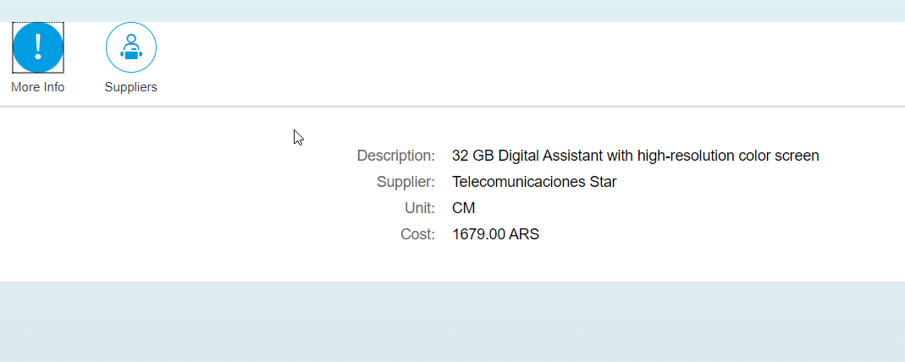
Getting Detail Screen data
Step1: Changing the View2 controller Code.
Step 2: View2 code.
Step 3: Fragment code.(supplier , moreInfo)

Slide 4

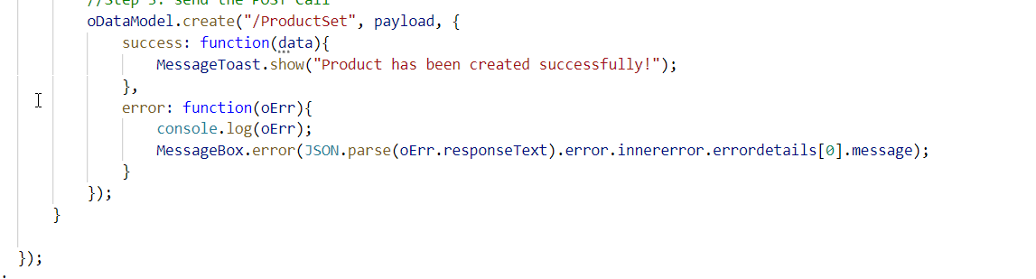
Performing Post From UI
Step1: Create Add Screen for User.
Step2: Create Add Controller .
Step3: Creating Footer on View1 Screen With Add Button.
Step4: Creating Entry for Add View in manifest.json .
Step5: Write add button logic in View1 Controller .

Slide 5
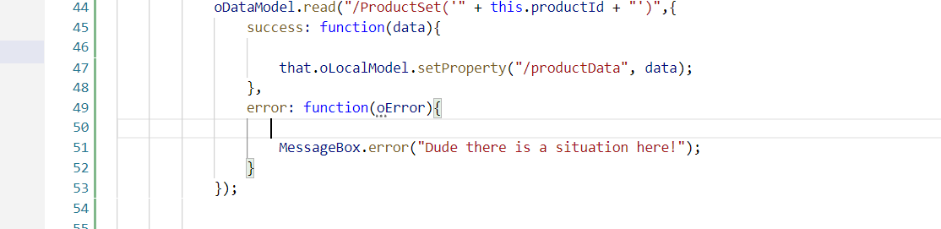
Performing GET(Single) From UI
Step1: Add change event in the Id Filed of Add Screen
Step2: When we put ID in that field it should load that entry.
Step3: Add OnLoad Function in Add Controller

Slide 6
Performing Delete From UI
Step1: Add Delete button on Add Screen footer
Step2: When we click the button it should delete that entry.
Step3: Add OnLoad Function in Add Controller

Slide 7
Function Import
Calling the Function Import From UI
Step1: Add a button on Add Screen which calls the function import.
Step2: add the button press logic in Add Controller
var oDataModel = this.getView().getModel();
var that = this;
oDataModel.callFunction("/GetMostExpensiveProduct",{
urlParameters: {
"I_CATEGORY": 'Notebooks'
},
success: function(data){
},
error: function(oError){
}
});

Slide 8
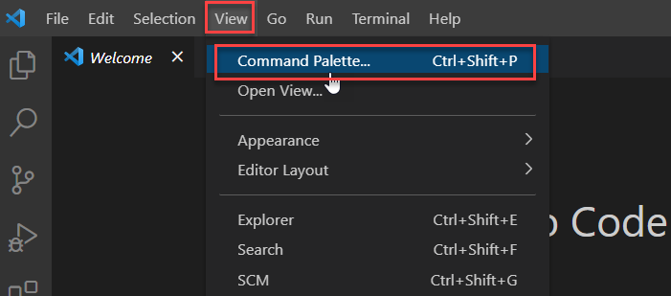
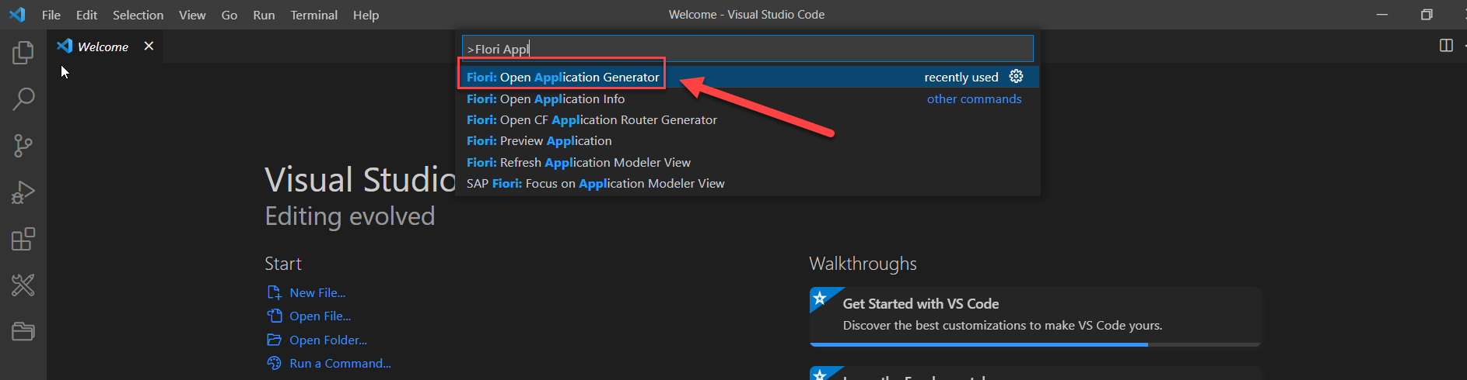
Creating Fiori App In VS-Code
Creating the Fiori App in VS Code Using Template
Step1: Go to View and Select Command Palette or Press Ctrl+shift+P
Step2: Search For Fiori: Open Application Generator

Slide 9

End of Day 18

Slide 10

Questions

Slide 11

Anubhav Oberoy

Slide 12


We’re committed to empower you to be
Most Desirable Resource
through powerful training solutions.
We build the workforce of the future.
250+
Corporate Clients
30,000+
Learners Trained
25000+
Learners Placed
FREE WEBINARS
Sign up for free webinars with industry experts every fortnight!
Enroll Now!
Contact us today!
https://anubhavtrainings.com/

Slide 13




More from AnubhavTrainings.com

